Slide 1
EDSR and SRGAN
Model Explanation and Results

Slide 2
EDSR (Enhanced Deep Residual Networks for Single Image Super-Resolution)
[ Winner of NTIRE (New Trends in Image Restoration and Enhancement) 2017 Challenge on Image Super-Resolution. ]

Slide 3
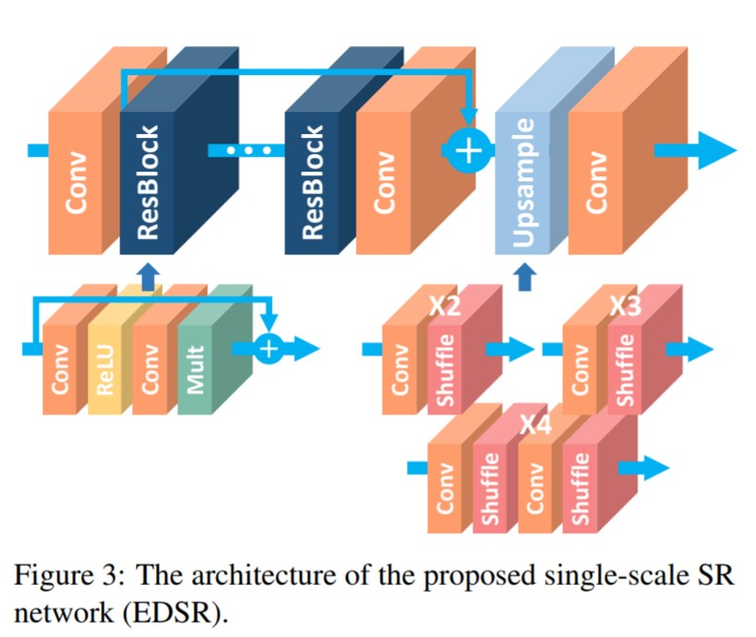
Key features
32 ResBlocks & 256 channels.
Removed Batch Normalisation (they claim input LR image and output SR image belong to same distribution). This also saves 40% memory.
Local-Global skip connections.
Upscaling at the end/last step.
Use L1 Loss function (even though general convention is to use L2 loss as it is directly related to PSNR) as it gives better performance and convergence.
Use self ensemble techniques by simply transforming(flip/rotate) the input images & then averaging over the outputs to calculate loss (called EDSR+)

Slide 4
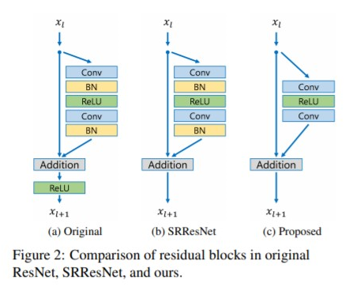
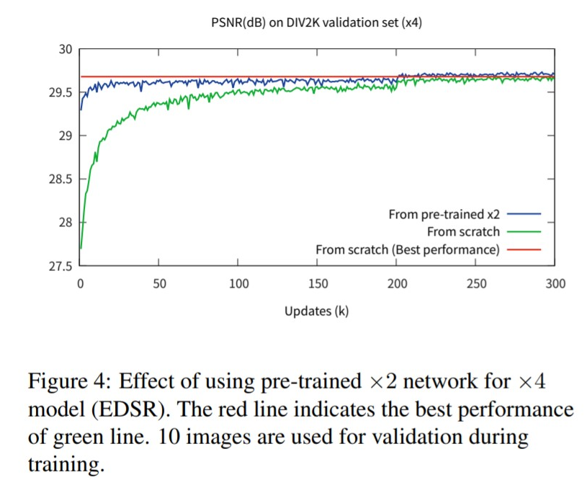
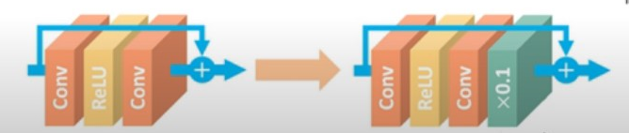
Key Differences
Previous approaches
EDSR approach
As #features is high (256), to maintain stability, a residual scaling factor of 0.1 is used.

Slide 5
Implementation Details
Hyper Param | Value/Details
Training Dataset | DIV2K (800 imgs for training)
Data Augmentation | Flip & rotation (x8) [done in EDSR+]
Mini batch size | 16
Depth | 32 ResBlocks
Width / #features | 256 channels
LR | 10⁻⁵ & halved every 2 x 10⁵ iterations
Optimizer | Adam (β1 = 0.9, β2 = 0.999, ϵ = 10⁻⁸)
Loss Function | L1
Residual scaling factor | 0.1

Slide 6
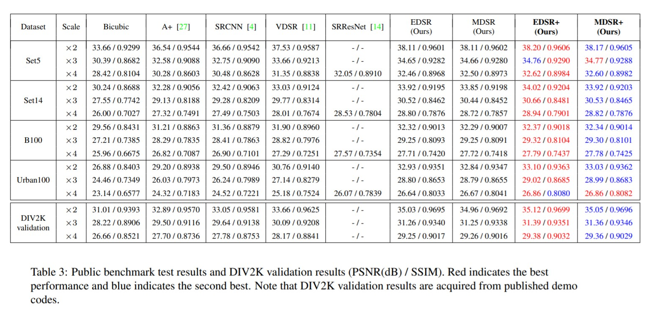
Results
The results mentioned above were replicated using their pre-trained model (for EDSR).

Slide 7
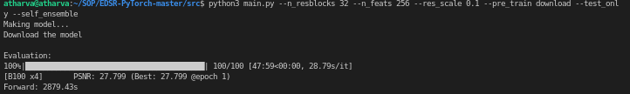
Eg. Snapshot of replicated result

Slide 8
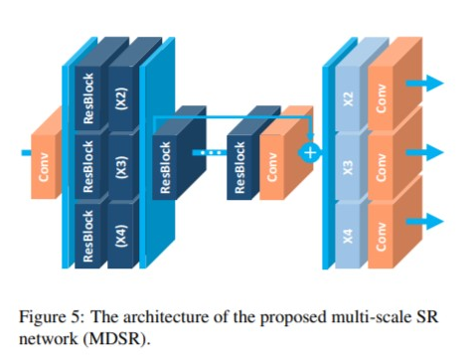
MDSR
Pre-processing unit
Final upscaling unit
A variant of EDSR, slightly lower performing
3-module structure:
Pre-processing (scaling factor dependent)
Main
Upscaling (scaling factor dependent)
Used for multi scale upscaling (i.e. x2, x3, x4 can all be achieved by using same model).
Central/ main unit

Slide 9
SRGAN
A GAN based approach to Super Resolution

Slide 10
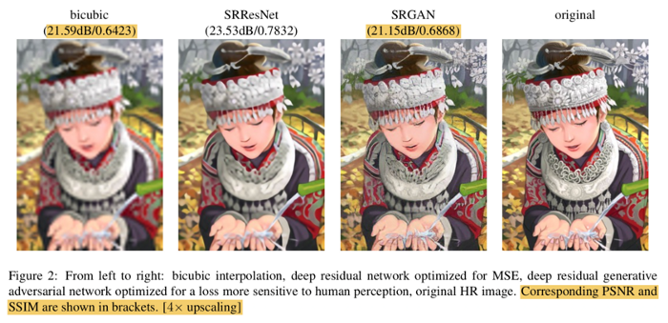
Key points
A GAN based approach
High upscaling factors (4x)
Optimised on perceptual loss (instead of MSE) to result in visually appealing images.
Uses Batch Normalization for faster training by removing internal covariate shift

Slide 11
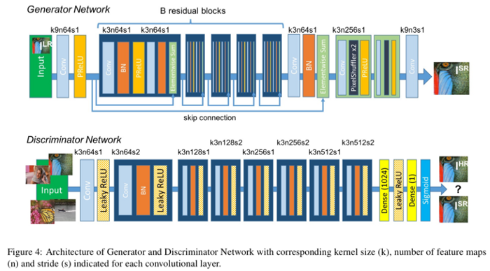
Model Architecture
A low resolution image (ILR) is obtained by applying a gaussian filter to a high resolution image (IHR) followed by a down-sampling operation with down-sampling factor r.
•ILR is given as : W x H x C
•IHR and ISR are given as : rW x rH x C
1. Generator function G estimates for a given input LR image its corresponding HR image which is a super resolved image SR.
2.Discriminator D is trained to distinguish super resolved images and real images.
Input Image (Low res): ILR
Output Image(Super res): ISR
Ground Truth(High res): IHR

Slide 12

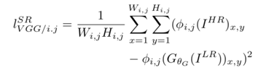




Loss Function
Objective Function
Perceptual Loss
Generator
Discriminator

Slide 13
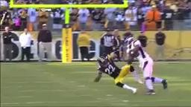

Input video (144 px)
Original
SR Output

Slide 14
Output Video (on 144 px input)

